Slide 1


ISI4E3-English for Academic Writing Purposes
Paraphrasing Your Sentences
Department of Information System
School of Industrial Engineering
Telkom University
Notes:
Hello everyone. My name is Ima Normalia Kusmayanti. My students call me Miss Ima. Let’s learn English for Academic Writing Purposes. In these slides, I will explain to you about paraphrasing your sentences.

Slide 2
Course Learning Outcomes - CLOs
CLO 01
CLO 02
CLO 03
use simple and compound sentences in present and past tenses, present continuous, and present perfect tense to present some interesting facts about skills and abilities in the form of a short paragraph with “intermediate mid” fluency level.
use simple, compound, and complex sentences in present tense, present continuous tense, and present perfect tense to present interesting facts about the roles of information system in our lives today in the form of a short paragraph with “intermediate-high” fluency level.
state their opinions with relevant and interesting proofs related to their innovative technology creations in the form of 3-5 paragraph essay using present tense, present continuous tense, present perfect tense, and past tense with “low-advanced” fluency level.
Notes:
This is the third lesson that will help you achieve the second course learning outcome.

Slide 3
Using information from other sources
Quoting – where you use someone else’s exact words.
Paraphrasing – when you include ideas from a source in your own words without changing the original meaning.
Summarizing – which involves putting the main ideas from a source into your own words.
Notes:
In academic writing, assignments often involve incorporating information from published sources into your own work to support your ideas. There are three main ways to do this: Quoting – where you use someone else’s exact words, Paraphrasing – when you include ideas from a source in your own words without changing the original meaning, and Summarising – which involves putting the main ideas from a source into your own words.

Slide 4
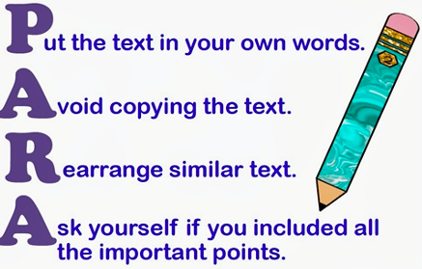
Paraphrasing
Picture is downloaded from https://lasalle-academy.libguides.com/c.php?g=596216&p=4124834
Notes:
In this lesson, we only focus on learning about paraphrasing. Paraphrasing is when you rewrite what someone said or wrote in your own words, without changing the original meaning. Paraphrasing is putting something in your own words. As you can see here, PARA, the first four letters in the word “paraphrasing” stands for P-put the text in your own words, A- avoid copying the text, R-rearrange similar text, and A-ask yourself if you included all the important points.

Slide 5
Original Paragraph
Information Systems are designed to improve the overall efficiency and effectiveness of a process, such as bank transactions. For instance, Citibank developed the Automatic Teller Machines and Bank Debit Cards in 1977. Consequently, they made financial transactions easy and were a huge success. Further, banks continued to innovate and most of the customer can do majority of transaction from their home computer or even from mobile telephone with more reliable and secure information system. Moreover, information systems provide real time information which reduces the scope of errors, hence, increases the quality of the output of the process. These examples prove the importance of information systems in our lives.
Check for plagiarism using Grammarly
Picture is downloaded from https://content.techgig.com/5-skills-you-should-have-to-crack-an-interview/articleshow/74694767.cms
Notes:
Let’s do a plagiarism check.

Slide 6
Checking Plagiarism
https://www.grammarly.com/plagiarism-checker
Notes:
Let’s visit this site.

Slide 7
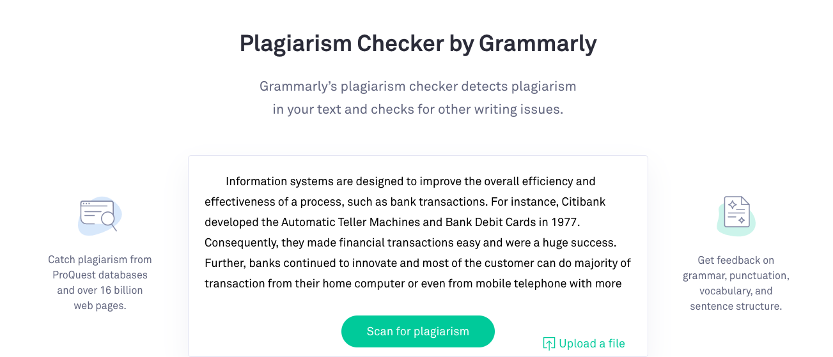


Plagiarism Checker
Notes:
As you can see here, there was a significant plagiarism detected.

Slide 8


Slide 9
Paraphrasing
Change the sentence structures.
Change the words in the sentences.
Notes:
When you paraphrase it is important to change the structure of the text you are using and change the words. Let’s learn how to do these two ways to paraphrase your English sentences.

Slide 10



Change the sentence structures
Notes:
First, let’s learn how to change the sentence structures using active and passive voices and the four sentence structures.

Slide 11
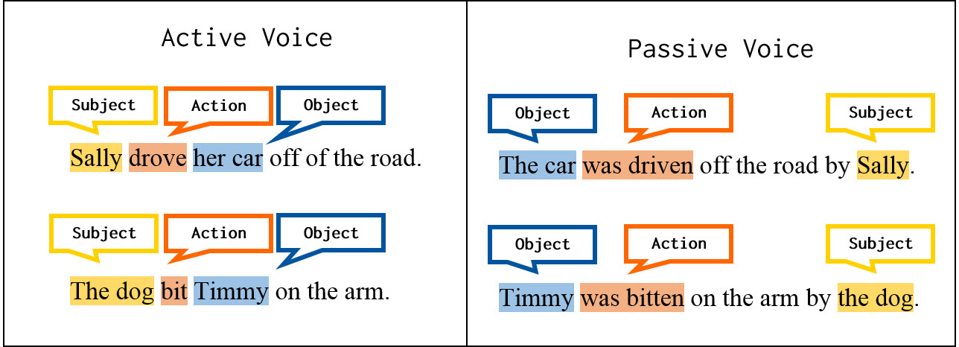
Active vs. Passive Voice
Picture is downloaded from https://writingcenter.ashford.edu/active-vs-passive-voice
Notes:
Do you remember active and passive voice in English grammar? The order of a sentence with an active voice is subject, action, and object. Meanwhile, the order of a passive voice is object, action, and subject. Usually there is a preposition “by” in a passive voice or sometimes, you can omit the preposition “by”.

Slide 12

Active to Passive
For instance, Citibank developed the Automatic Teller
Machines and Bank Debit Cards in 1977.
Action Verb
Direct Object
Direct Object
Notes:
Before changing active sentence into passive sentence, you must identify three parts of sentences: the subject, the active verb, and the direct object. If you cannot find these three parts in a sentence, it means you cannot change the active sentence into passive sentence. Now, this sentence has a subject which is “Citibank”, the action verb which is “developed”, and two direct objects: the Automatic Teller Machines and Bank Debit Cards.

Slide 13
Active to Passive
For instance, Citibank developed the Automatic Teller Machines and Bank Debit Cards in 1977.
For instance, the Automatic Teller Machines and Bank Debit Cards were developed in 1977 (by Citibank).
For instance, the Automatic Teller Machines and Bank Debit Cards were developed in 1977.
Notes:
This is an example of changing the active sentence into passive one. You rearrange the position of the direct object in the beginning of the sentence. Then, you add “helping verb” were. Remember, there is an adverb of time “1977”, it means the helping verb is in past tense. So, the verb in the passive sentence is “were developed”. Usually there is a preposition “by” in a passive voice or sometimes, you can omit the preposition “by”. Here, you can omit the preposition “by”.

Slide 14
Passive to Active
Third, medical care has greatly been improved
(thanks to = by) the inception of computer in the
health sectors.
Direct Object
Action Verb
Notes:
Similar case to changing active to passive, when changing passive to active, you also need to identify three parts of a sentence: the subject, the action verb, and the direct object.

Slide 15
Passive to Active
Third, medical care has greatly been improved (thanks to = by) the inception of computer in the health sectors.
Third, the inception of computer in the health sectors has greatly improved medical care.
Notes:
This is an example of a passive sentence becomes an active sentence.

Slide 16

Constructions:
Simple
Compound
Complex
Mixed
Picture is downloaded from https://www.quickanddirtytips.com/education/grammar/sentence-length
Notes:
Besides active and passive voices, you can also rearrange your sentences using four sentence constructions.

Slide 17


One compound sentence =
two simple sentences
For instance, the Automatic Teller Machines and Bank Debit Cards were developed in 1977.
For instance, the Automatic Teller Machines was developed in 1977.
For instance, the Bank Debit Cards was developed in 1977.
Notes:
As you can see in this sentence, you transform one compound sentence into two simple sentences.

Slide 18
Two compound sentences =
one compound sentence
For instance, Citibank developed the Automatic Teller Machines and Bank Debit Cards in 1977. It made financial transactions easy and was a huge success.
For instance, the Automatic Teller Machines and Bank Debit Cards were developed in 1977, made financial transactions easy, and were a huge success.
Notes:
Here, you transforming two compound sentences into just one compound sentence.

Slide 19


Change the words in the sentences
Picture is downloaded from https://noworryenglish.wordpress.com/2014/10/07/how-to-enrich-your-vocabulary-pahami-bentuk-kata/
Notes:
Second, let’s learn how to change the words in the sentences. Remember, to change the words in the sentences, you must identify the nouns, the adverbs, the adjectives, and the verbs. These four parts of speech can be replaced using synonymous words.

Slide 20
Changing the nouns, adverb, and verb
Third, the inception of computer in the health sectors has greatly improved medical care.
Third, the invention of computer in the health departments has significantly enhanced medical care.
Notes:
Use a reliable dictionary to help you find proper synonymous words.

Slide 21
Plagiarism Checker
Notes:
As you can see here, there was a significant plagiarism detected.

Slide 22

Paraphrased Paragraph
Information Systems refine the entire efficiency and effectiveness of bank transactions. For instance, Automatic Teller Machines and Bank Debit Cards were developed in 1977, made financial transactions easy and were an immense triumph. Further, banks continued to innovate. Majority of customers can do most transactions from their home computer. Even they can do bank transactions from mobile telephone with more reliable and secure information system. Moreover, information systems supply real time information reducing the scope of errors. Hence, the real time information increases the quality of the process output. These examples prove the importance of information systems in our lives.
Notes:
As you can see here, plagiarism was not detected.

Slide 23
Paraphrasing
Change the sentence structures.
Change the words in the sentences.
Notes:
We have discussed the two ways to paraphrase your sentences.

Slide 24
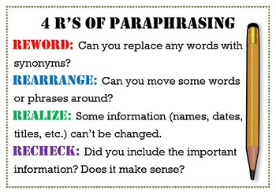
Picture is downloaded from https://www.teacherspayteachers.com/Product/4-Rs-of-Paraphrasing-Poster-4394593
Notes:
Remember, when you paraphrase a sentence or a paragraph or a text, do these four steps: reword, rearrange, realize, and recheck.

Slide 25

Picture is downloaded from https://quotesgram.com/quotes-about-language-learning/
Notes:
This is the end for the slides of Paraphrasing your sentences. I hope by now, you are familiar with the two ways to paraphrase your English sentences to avoid plagiarism. As Frank Smith said “one language sets you in a corridor for life. Two languages open every door along the way”. Good luck!

